Slide 1
Restaurant Manager
CSE-216 Term Project
Rittik Basak Utsha – 1705105
Nuraiyad Nafiz Islam - 1705114

Slide 2
Features – Customer Side
Create Account – Create user accounts using basic information
Log In – Log into account using ID and password to view menu or to order food online
View Menu – View items and their price from the menu
Cart – Add food items in cart for ordering later
Order Food – Order food added to the cart
View Previous Orders – View past orders based on given filters

Slide 3
Features – Admin Side
Place Orders – Place orders for customers in dine in service and generate bill
Note Expenses – Add daily expenses of different categories
View Employee Details – Add or edit employee information or just view them
View Sales Info – View sales and expenses data based on given filters
Online Orders – View pending online orders

Slide 4
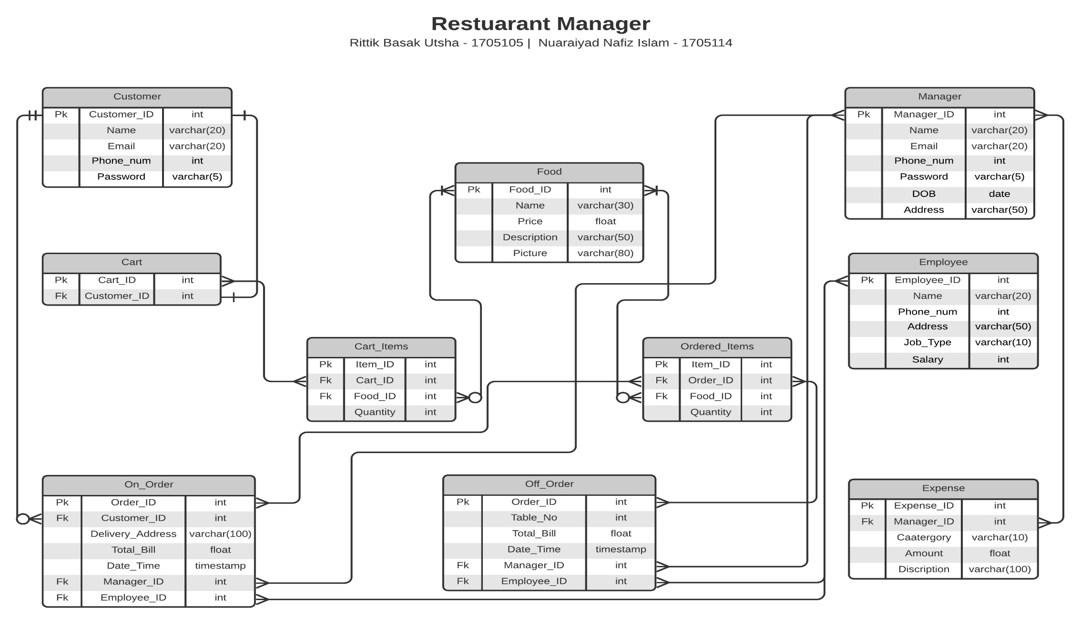
ERD

